Slide 1
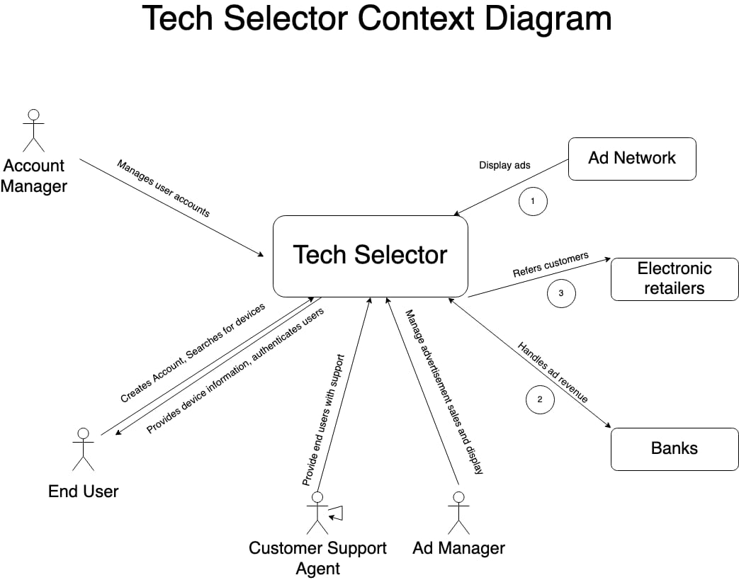

Slide 2
System Interface Table
No | Description | Source | Target | Frequency | Validation
1 | Provide Device Information | Device Database | Tech Selector | Real-time | Stores Information about all Devices added to website.
2 | Provide Review Score | Electronics Reviewers | Tech Selector | Real-time | Predict the rating user would give to a device. Items are then sorted by utility and are presented.
3 | Refers customers | Electronics Retailers | Tech Selector | Real-time | Redirect Customer to the website where they can find best deals for their products.
4 | Handles ad Revenue | Banks | Tech Selector | Real-time | Revenue Generated will be taken care by the banks.

